Slide 1
Computer Networks & IOT (18B11CS311)
Even Semester_2022
1
Notes:
1

Slide 2
Textbook
Prerequisite:
book
Textbook
1. Computer Networking: A Top-Down Approach Featuring the Internet, 7th Edition, James F. Kurose, Keith W. Ross
2. TCP/IP Protocol Suite – B. Forouzan
Reference Books
1. Computer Networks-Tannenbaum
2. Computer Networks-A Systems Approach- L Peterson
2
Notes:
2

Slide 3
Grading Policy
Assignments:
Tutorial sheets
Assignments/Quiz
Mini Project
T1, T2 and T3
Attendance
3
Notes:
3

Slide 4
Lectures & Assignments
Objective
Deep understanding of basic and fundamental networking concepts, architectures, and philosophies
IMPORTANT: this course is NOT about setting up your router at home, or writing a twitter program!!
Approach: how to do well in this course
Easy: attend ALL lectures and do ALL assignments
Do your assignments individually
Practice well
4
Notes:
4

Slide 5
Course Objectives
COURSE OUTCOMES |  | COGNITIVE LEVELS
CO1 | Defining the basics of networking, components and underlying technologies | Remembering (Level 1)
CO2 | Illustrate the various key protocols in OSI model and TCP/IP protocol suite and explain various application protocols. | Understanding (Level 2)
CO3 | Examine various transport protocols and its performance enhancing mechanisms. | Analysing (Level 4)
CO4 | Determine the shortest path for the network using various routing protocols and evaluate it. | Evaluating (Level 5)
CO5 | Choose IP & MAC addressing mechanisms and data link layer protocols to solve communication, error detection and correction problems. | Applying (Level 3)
CO6 | Identification and description of various components, architectures and protocols of Internet of Things (IoT) and their real life problems. | Understand (Level 2)
5

Slide 6
Module No. | Subtitle of the Module | Topics in the module | No. of Lectures for the module
1. | Introduction | Network terminologies, Network Models, Protocol layers and their services, Connection Oriented and Connectionless services, Physical Media. | 04
2. | The Application Layer | Principles of Application-Layer Protocols, HTTP, File Transfer: FTP, DNS, Electronic Mail in the Internet | 4
3. | The Transport Layer | Transport-Layer Services and Principles, Multiplexing and Demultiplexing Applications, UDP and TCP, Connection Establishment, Transport Layer Protocols (go back N, stop and wait, selective repeat), Flow Control, TCP Congestion Control | 8
4. | The Network Layer | Introduction and Network Service Model, IP: the Internet IP addressing, Routing Principles, Protocol, Routing in the Internet, | 08
5. | The Link Layer and Local Area Networks | The Data Link Layer: Introduction, Services, Error Detection and Correction, Multiple Access Protocols and LANs, LAN Addresses and ARP, IEEE standards and Ethernet | 06
6. | Introduction to Internet of Things | Introduction to IoT, IoT reference Model - IoT Reference Architecture,M2M architecture, IOT devices | 05
7 | IoT protocols | Introduction to IOT protocols: IEEE 802.11, LoRaWAN, 6LoWPAN, RPL and MQTT and CoAP | 05
6

Slide 7
The Zettabyte Era
byte, kilobyte, megabyte, gigabyte, terabyte, petabyte, exabyte, zetabyte, yottabyte
7

Slide 8
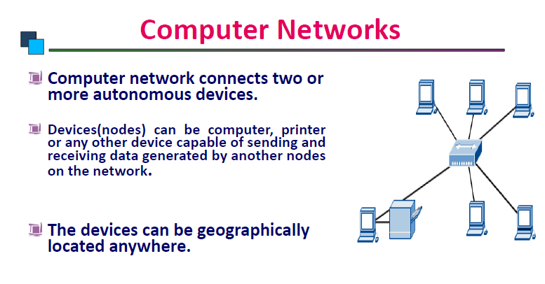
8

Slide 9
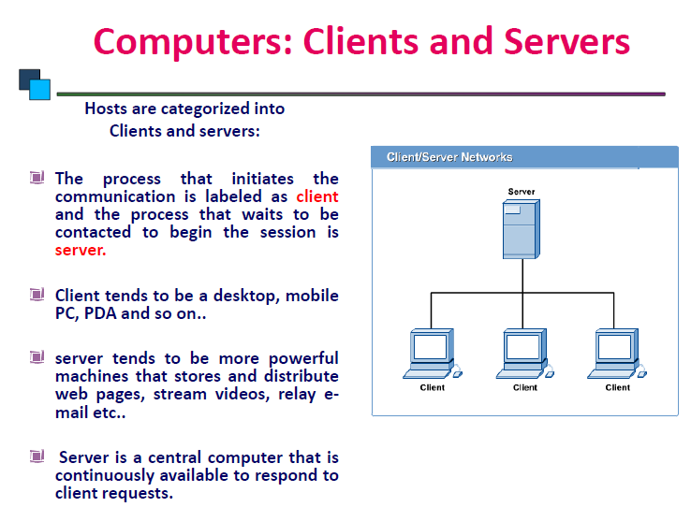
9
Notes:
Personal digital assistance
9

Slide 10
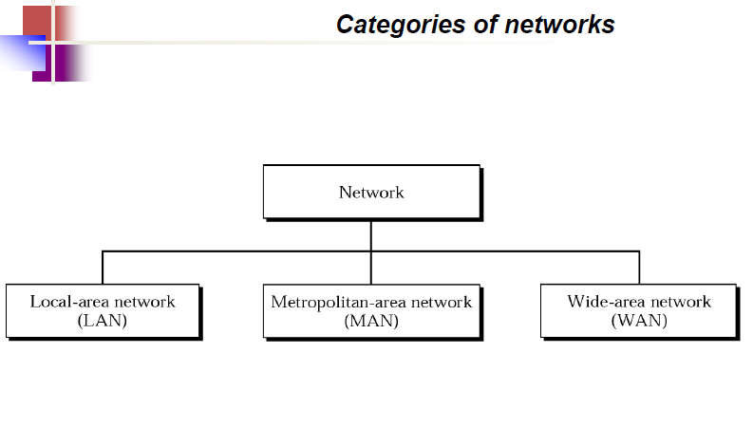
10

Slide 11
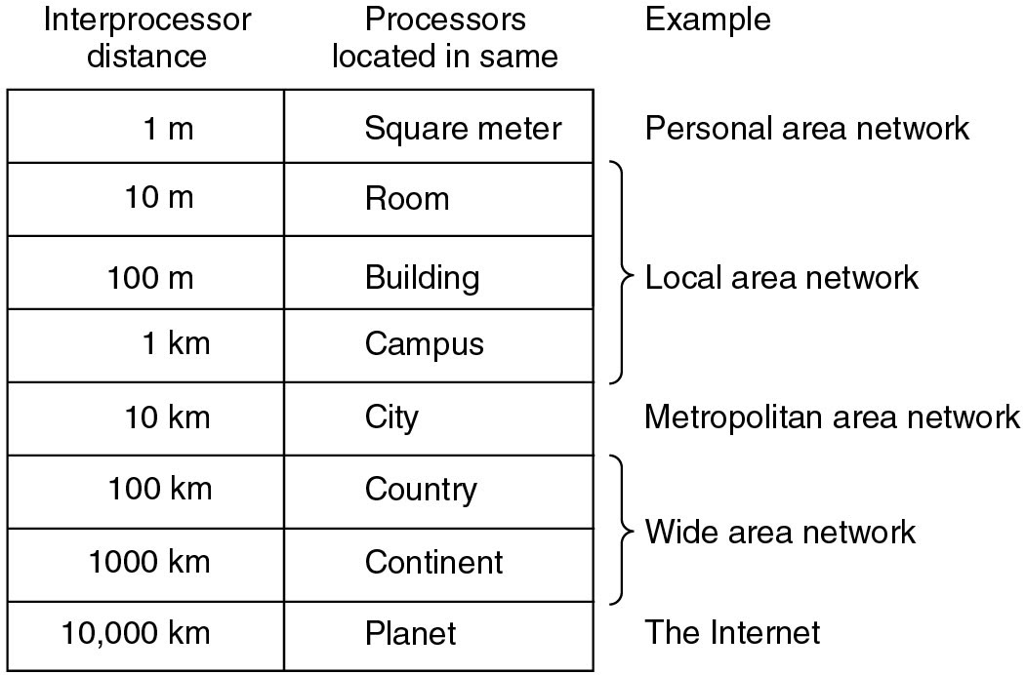
11

Slide 12
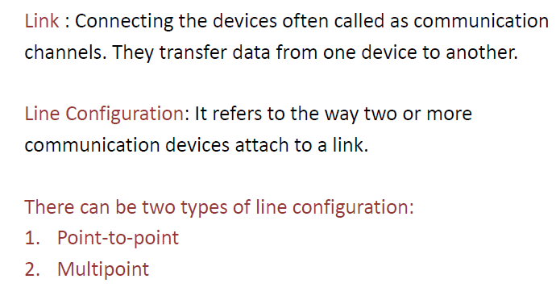
12

Slide 13
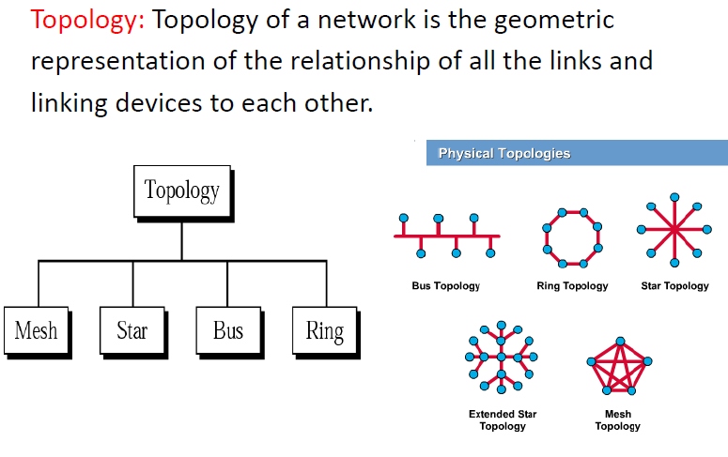
13

Slide 14
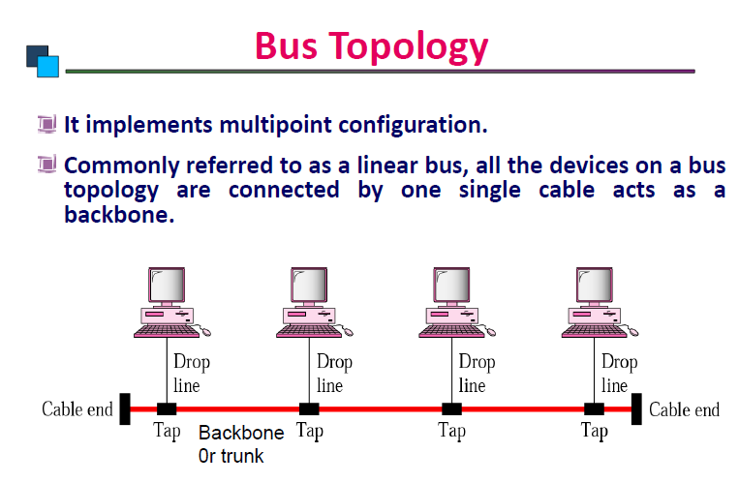
14

Slide 15
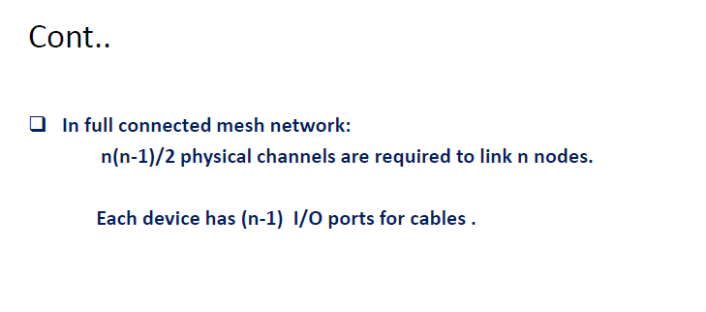
15

Slide 16
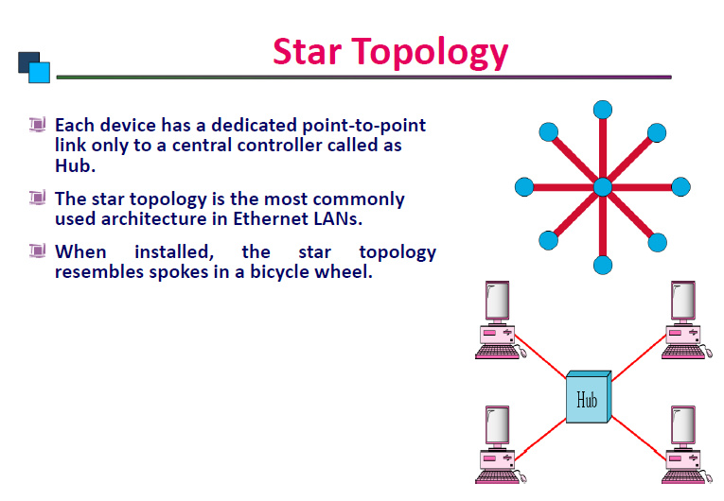
16

Slide 17
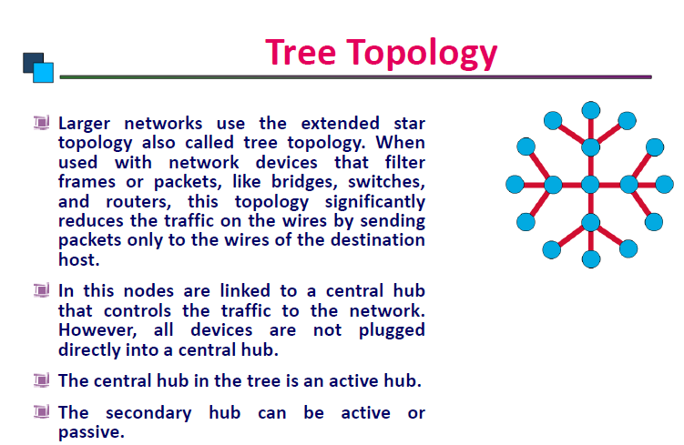
17

Slide 18
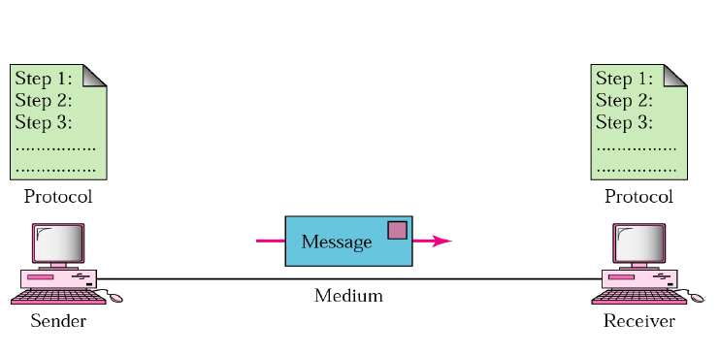
Components of the Network System
18

Slide 19
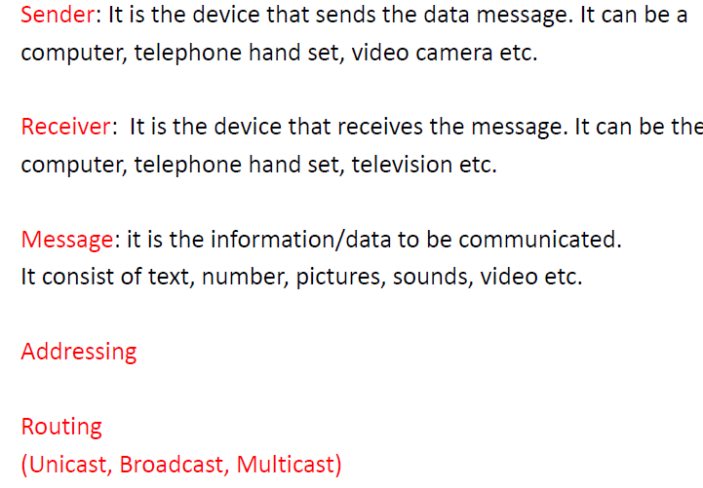
19

Slide 20
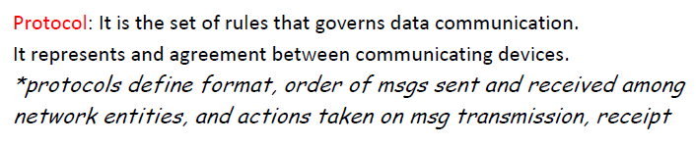
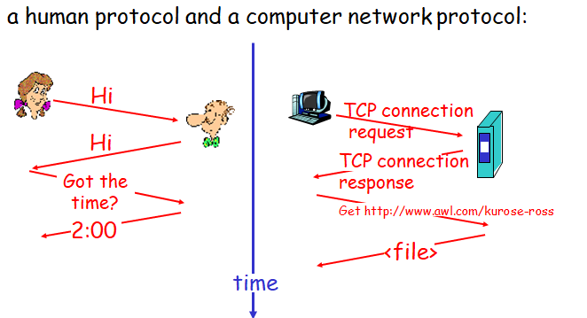
20

Slide 21
What’s a protocol?
human protocols:
“what’s the time?”
“I have a question”
introductions
… specific msgs sent
… specific actions taken when msgs received, or other events
network protocols:
machines rather than humans
all communication activity in Internet governed by protocols
protocols define (1) format, order of msgs sent and received among network entities, and (2) actions taken on msg transmission, receipt
21
Notes:
21

Slide 22
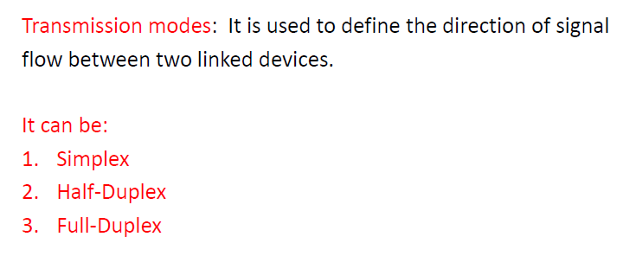
22

Slide 23
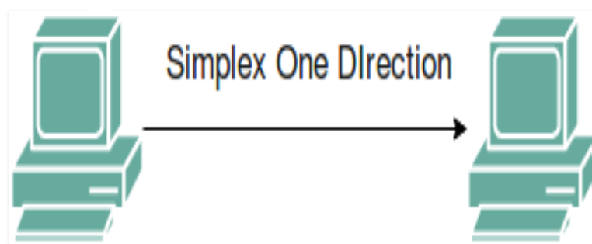
In Simplex mode, the communication is unidirectional, as on a one-way street. Only one of the two devices on a link can transmit, the other can only receive.
The simplex mode can use the entire capacity of the channel to send data in one direction.

Slide 24
In half-duplex mode, each station can both transmit and receive, but not at the same time. When one device is sending, the other can only receive, and vice versa. The half-duplex mode is used in cases where there is no need for communication in both directions at the same time. The entire capacity of the channel can be utilized for each direction. Example: Walkie-talkie in which message is sent one at a time and messages are sent in both directions.

Slide 25
In full-duplex mode, both stations can transmit and receive simultaneously. In full duplex mode, signals going in one direction share the capacity of the link with signals going in another direction, this sharing can occur in two ways: 1. Either the link must contain two physically separate transmission paths, one for sending and the other for receiving. 2. Or the capacity is divided between signals travelling in both directions.

Slide 26
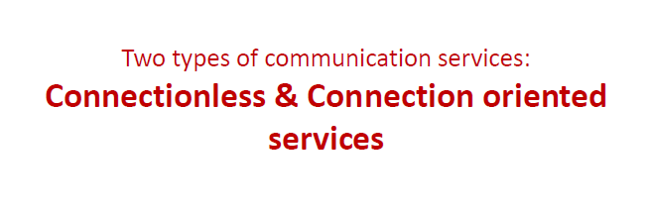
26

Slide 27
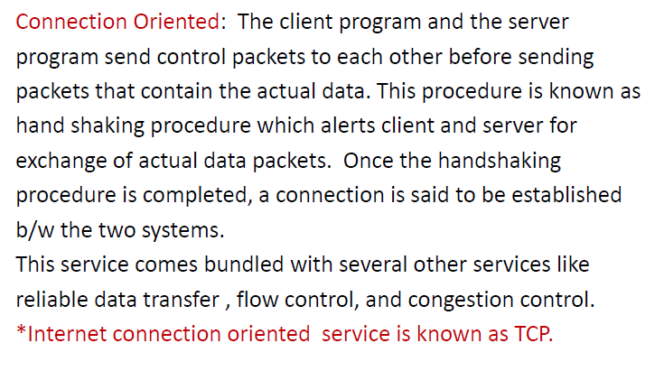
27

Slide 28
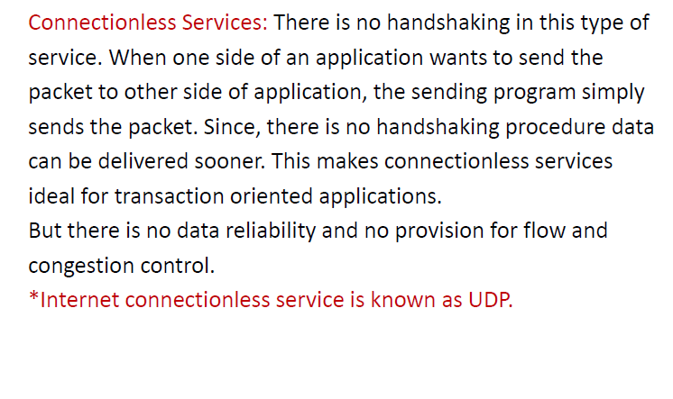
28

Slide 29
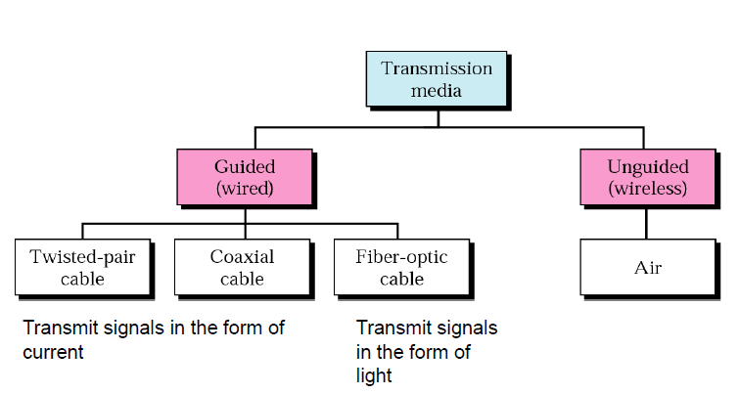
Physical Media
29

Slide 30
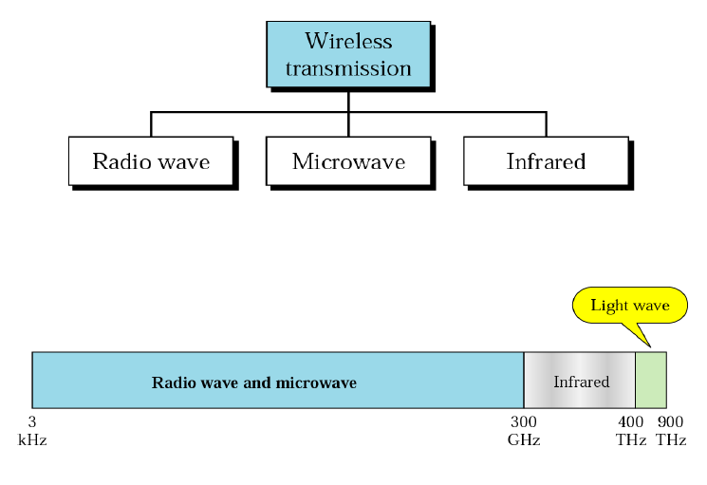
30

Slide 31








A closer look at network structure:
network edge: applications and hosts
network core:
routers
network of networks
access networks, physical media: communication links
31
Notes:
31

Slide 32


The network edge: service models
end systems (hosts):
run application programs
e.g. Web, email
at “edge of network”
client/server model
client host requests, receives service from always-on server
e.g. Web browser/server; email client/server
peer-to-peer model:
minimal (or no) use of dedicated servers
e.g. Skype, BitTorrent, KaZaA
32
Notes:
32

Slide 33
The Network Core
mesh of interconnected routers
the fundamental question: how is data transferred through net?
circuit switching: dedicated circuit per call: telephone net
packet-switching: data sent thru net in discrete “chunks”
33
Notes:
33

Slide 34
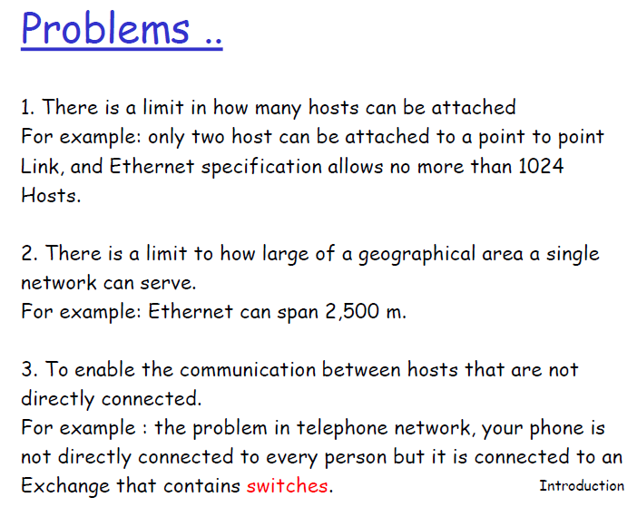
Switching Techniques
34

Slide 35
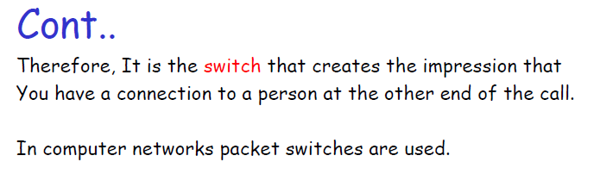
35

Slide 36
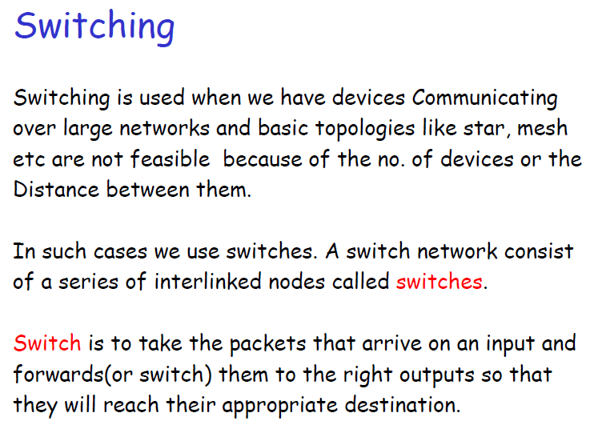
36

Slide 37
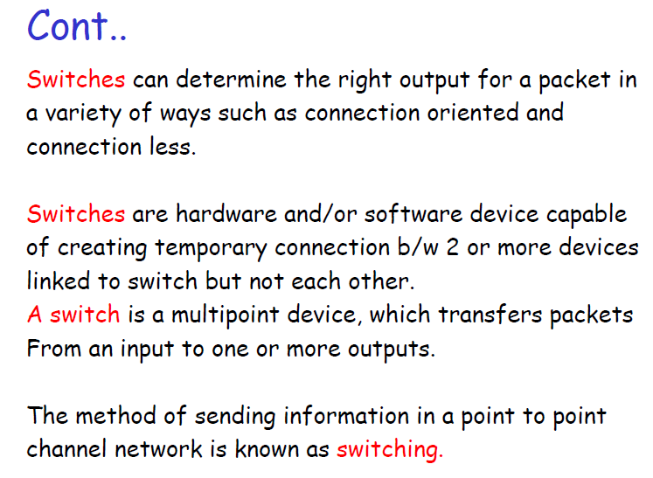
37

Slide 38
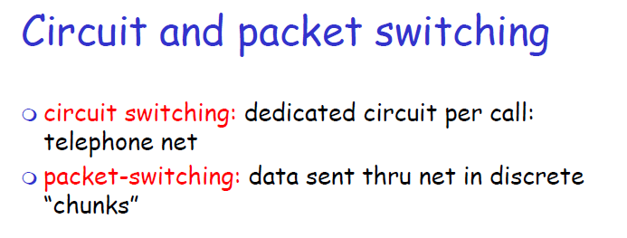
38

Slide 39
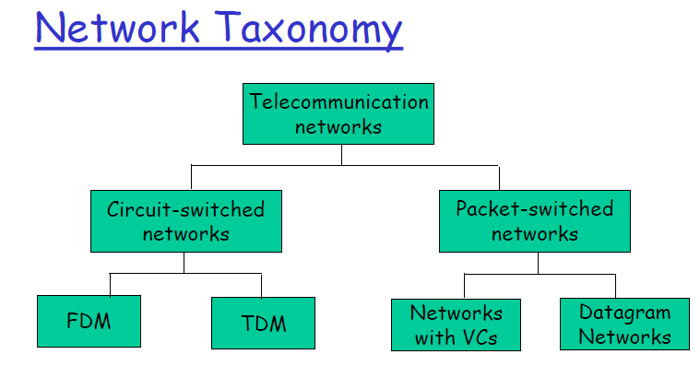
39

Slide 40
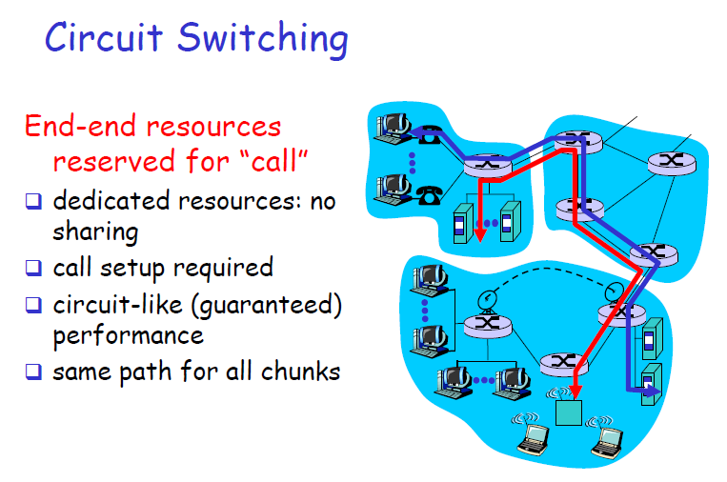
40

Slide 41
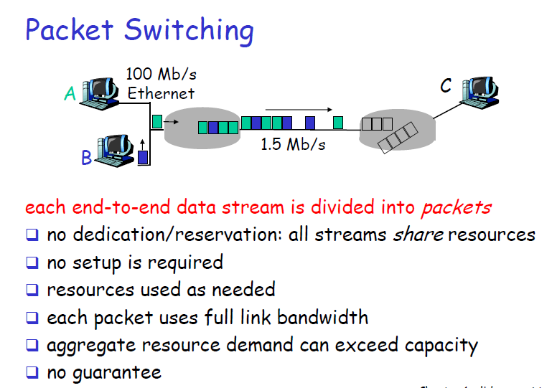
41

Slide 42
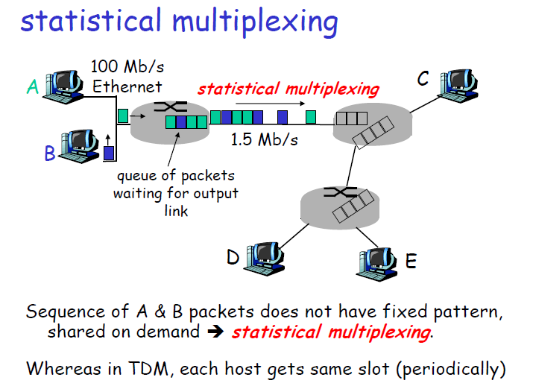
42
Notes:
42

Slide 43
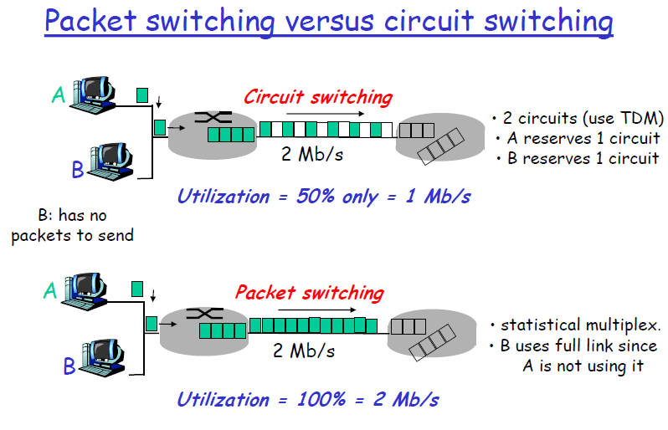
43

Slide 44
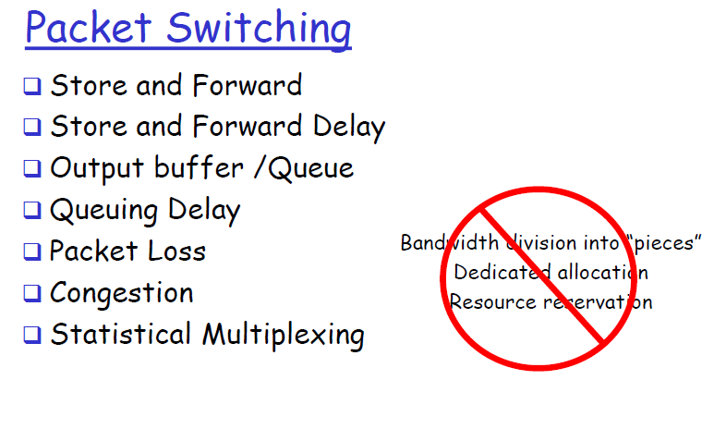
44

Slide 45
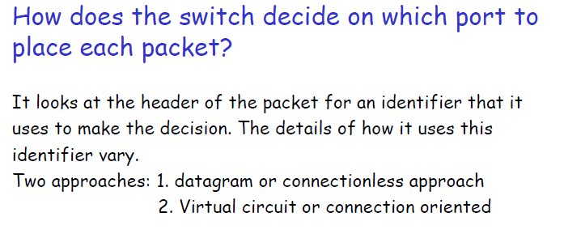
45

Slide 46
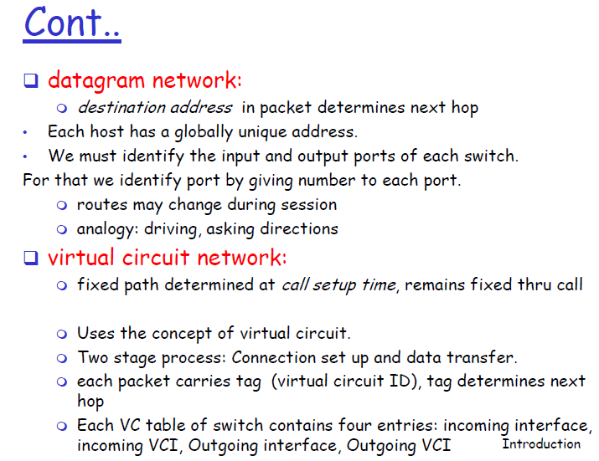
46

Slide 47
Delay & loss in packet switched network
47

Slide 48
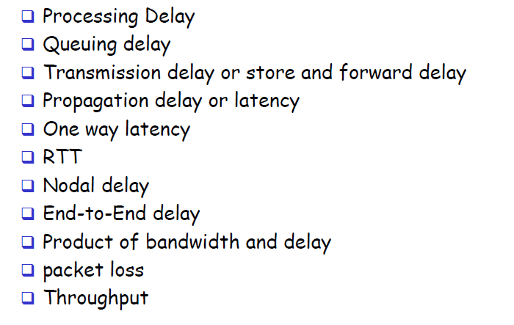
48

Slide 49
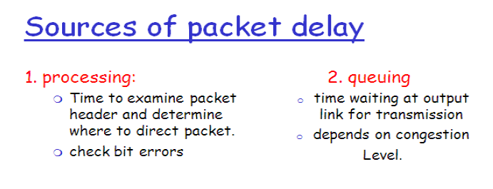
49

Slide 50
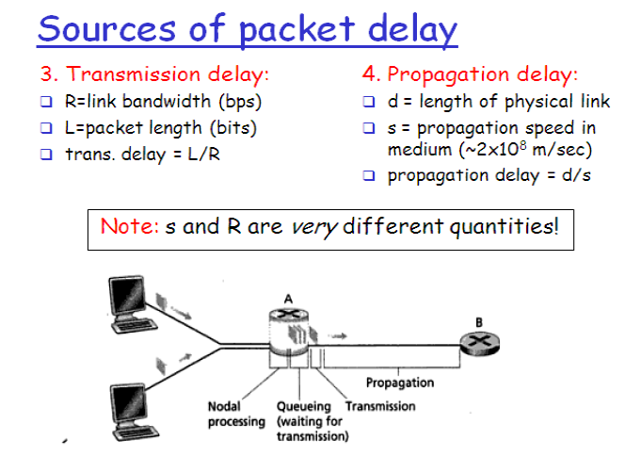
https://www2.tkn.tu-berlin.de/teaching/rn/animations/propagation/
50

Slide 51
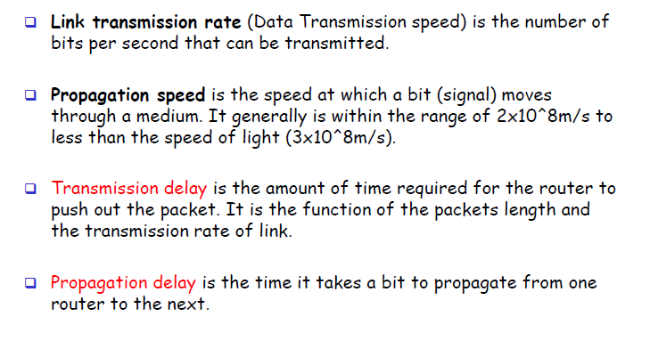
51

Slide 52
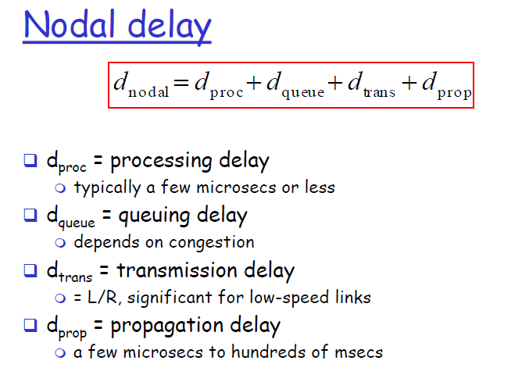
52

Slide 53
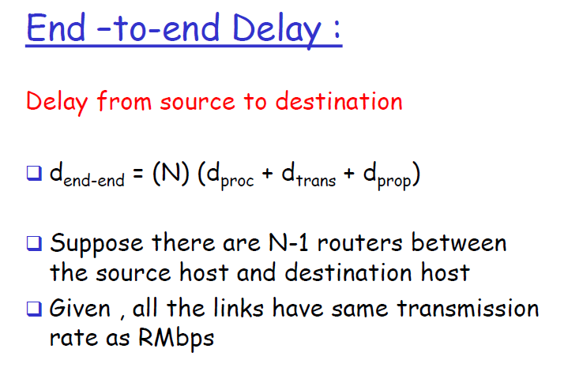
53

Slide 54
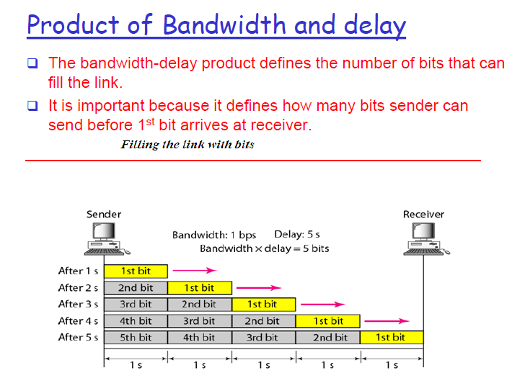
54

Slide 55
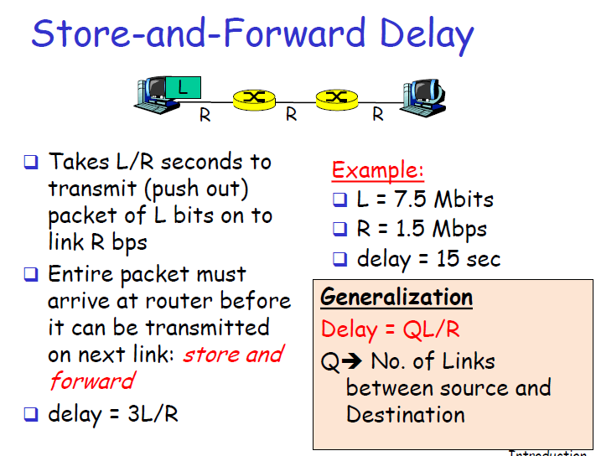
55

Slide 56
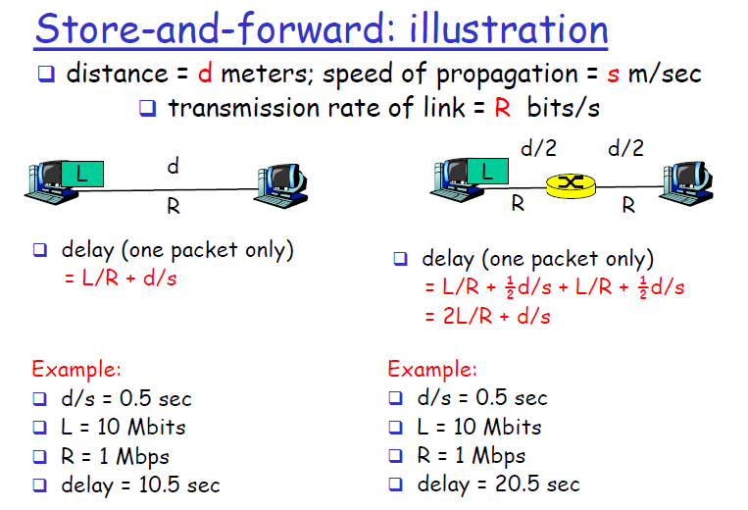
56

Slide 57
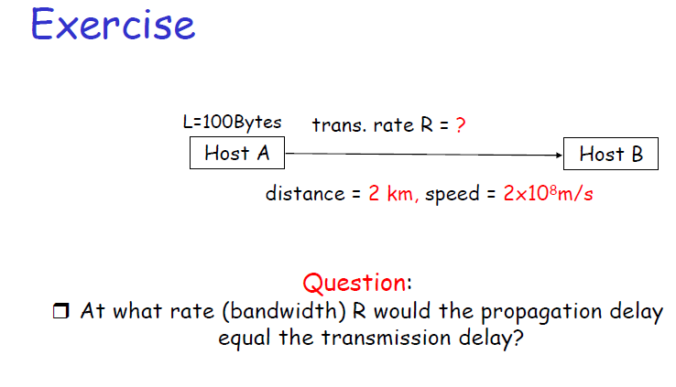
57

Slide 58
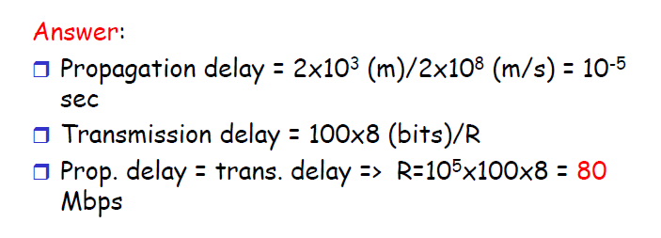
58

Slide 59
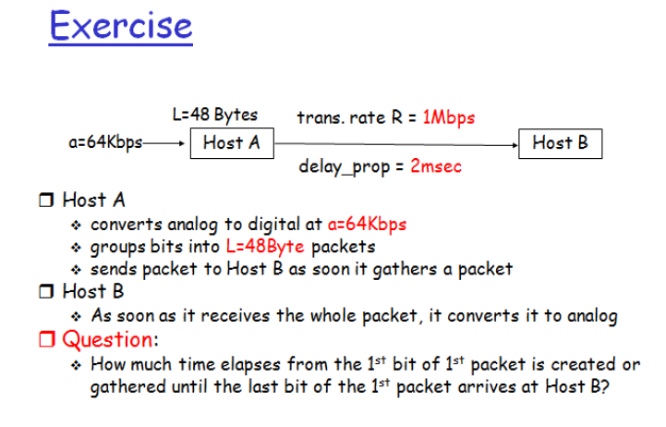
59

Slide 60
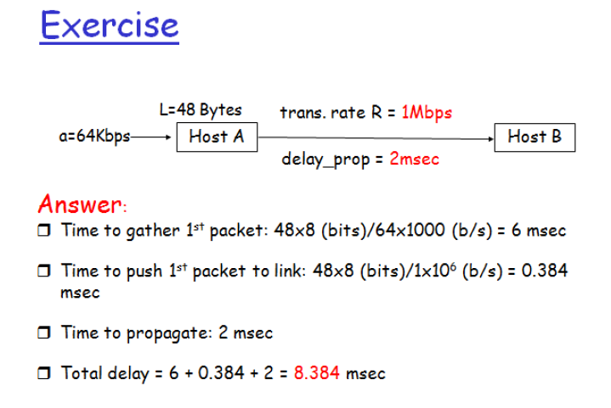
60

Slide 61
How much time will it take to send a packet of size L bits from A to B
in given setup if Bandwidth is R bps, propagation speed is
t meter/sec and distance b/w any two points is d meters
(ignore processing and queuing delay) ?
A---R1---R2---B
61

Slide 62
Total time = 3*(L/R + d/t) sec
62

Slide 63
Exercise
Suppose there is a 10 Mbps microwave link between a geostationary satellite and its base station on Earth. Every minute the satellite takes a digital photo and sends it to the base station. Assume a propagation speed of 2.4*10⁸ meters/sec.
a. What is the propagation delay of the link?
b. What is the bandwidth-delay product, R · dprop?
c. Let x denote the size of the photo. What is the minimum value of x for the microwave link to be continuously transmitting?
63

Slide 64
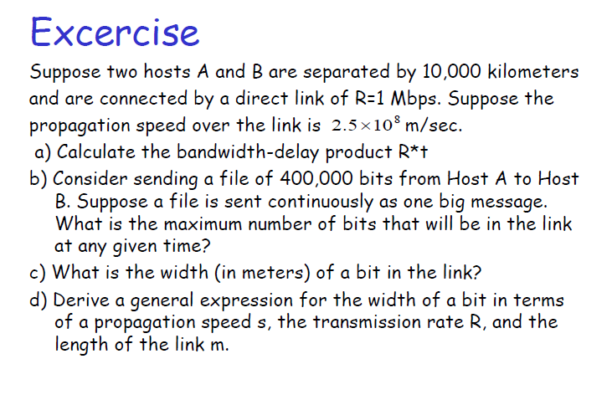
64

Slide 65
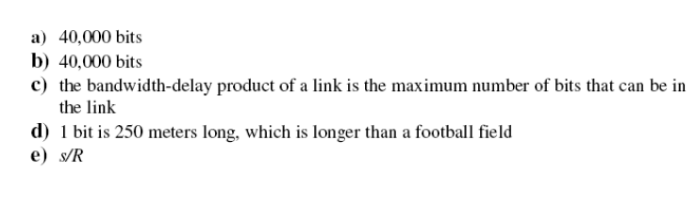
65

Slide 66
Question
How long does it take to send a file of 640,000 bits from Host A to Host B? Suppose that all links in the network use TDM with 24 slots and have a bit rate of 1.536 Mbps. Also suppose that it takes 500 msec to establish an end-to-end circuit before Host A can begin to transmit the file. How long does it take to send the file?
66

Slide 67
Each circuit has a transmission rate of (1.536 Mbps)/24=64 kbps, so it takes (640,000 bits)/(64 kbps)=10 seconds to transmit the file. To this 10 seconds we add the circuit establishment time, giving 10.5 seconds to send the file.
Note that the transmission time is independent of the number of links: The transmission time would be 10 seconds if the end-to-end circuit passed through one link or a hundred links.
67

Slide 68
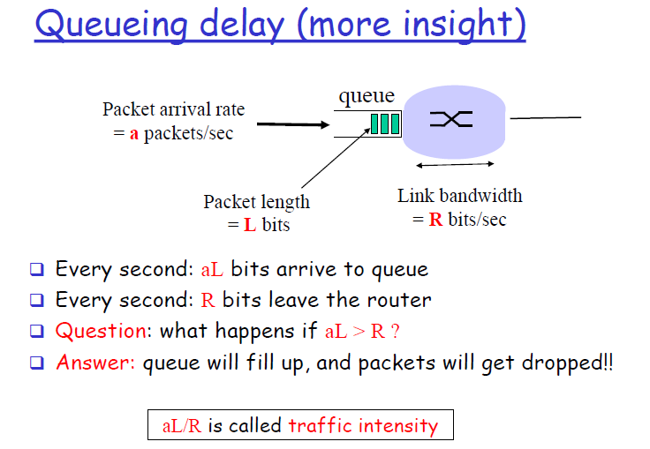
68

Slide 69

69

Slide 70

70

Slide 71

71

Slide 72

72

Slide 73

73

Slide 74

74

Slide 75
Layered Architecture of Network
75

Slide 76

76

Slide 77

77

Slide 78

78

Slide 79

79

Slide 80

80

Slide 81

Each layer defines a family of functions distinct from those of other layers. The architecture is both comprehensive and flexible. There is complete transparency between incompatible systems.
81

Slide 82

82

Slide 83

83

Slide 84

84

Slide 85

85

Slide 86

86

Slide 87

87

Slide 88

88

Slide 89

89

Slide 90

90

Slide 91

91

Slide 92

92

